Slide 1
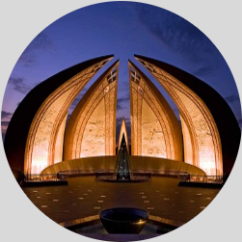


CSS
Tip
Circle image
Circle image using "border-radius" property
<img src="./monument.jpg" alt="" class="circle" />
.circle {
width: 250px;
height: 250px;
border-radius: 50%;
}
Follow
me for more tips

Slide 2
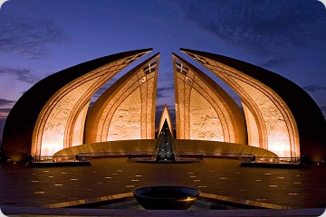
CSS
Tip
Round corner
Round corners using "border-radius" property
<img src="./monument.jpg" alt="" class="rounded-corner"/>
.rounded-corner {
border-radius: 12px;
}
Follow
me for more tips

Slide 3
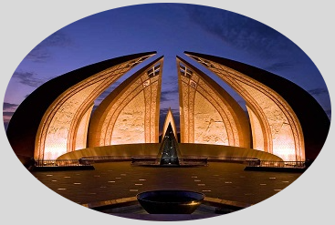
CSS
Tip
Oval image
Oval shape image using "border-radius" property
<img src="./monument.jpg" alt="" class="oval" />
.oval {
border-radius: 50%;
}
Follow
me for more tips

Slide 4

CSS
Tip
Profile image
Profile like image using "border-radius" property
<img src="./profile.png" alt="" class="profile" />
.profile {
width: 250px;
height: 250px;
border-radius: 50%;
background-color: yellowreen;
}
Follow
me for more tips

